Slide 1

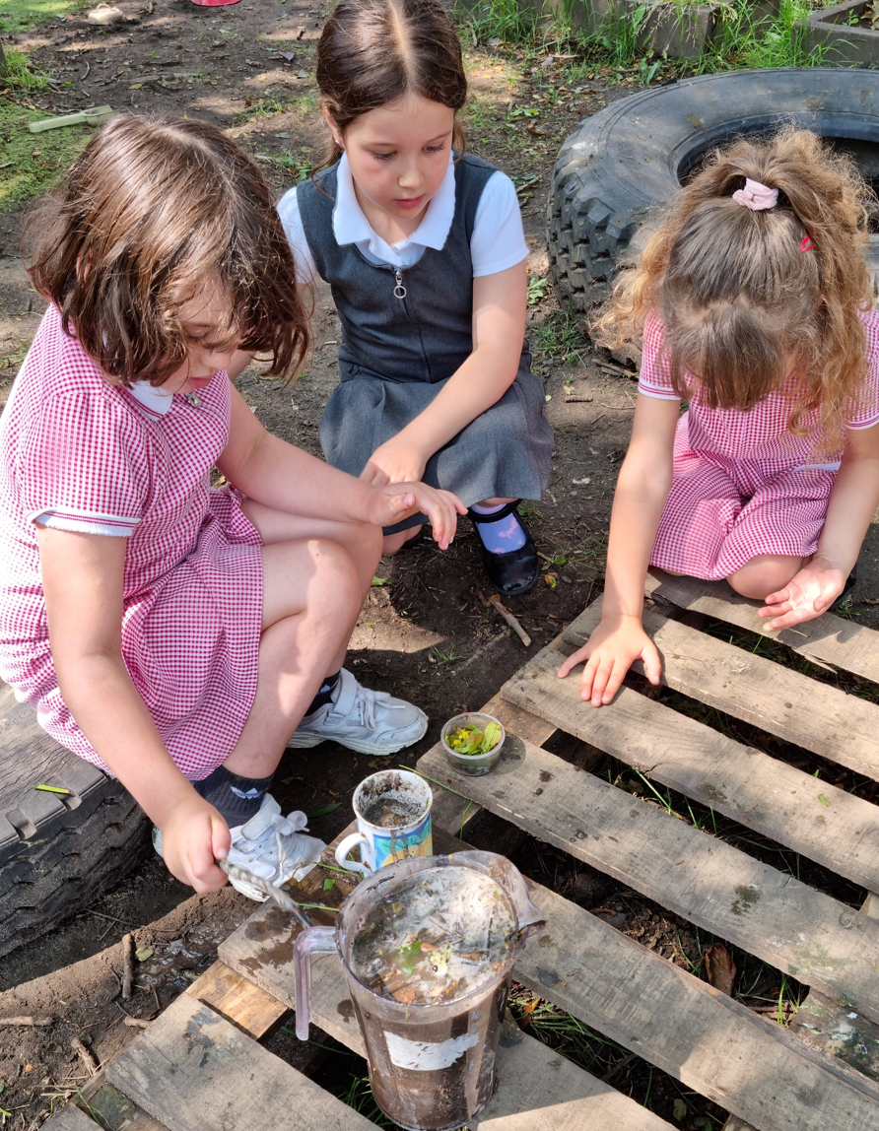
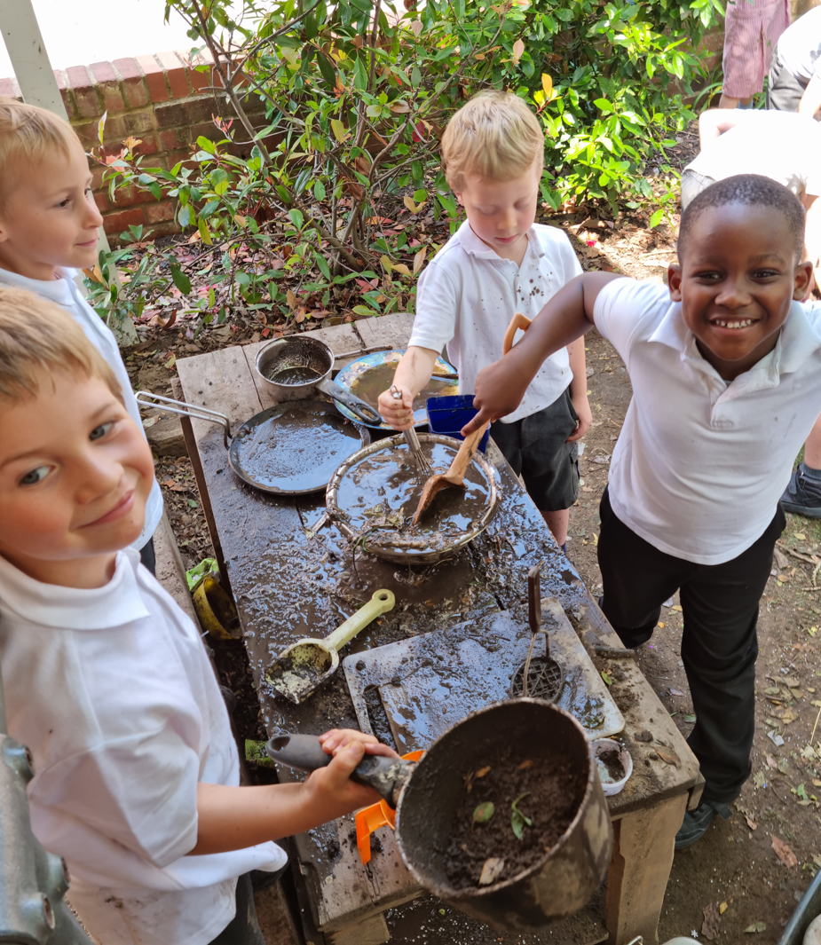
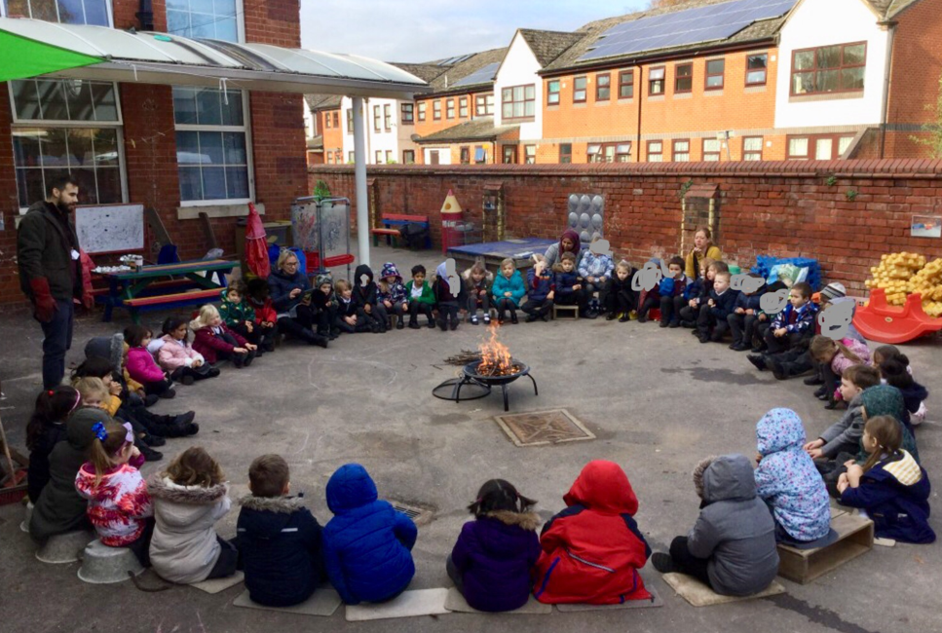
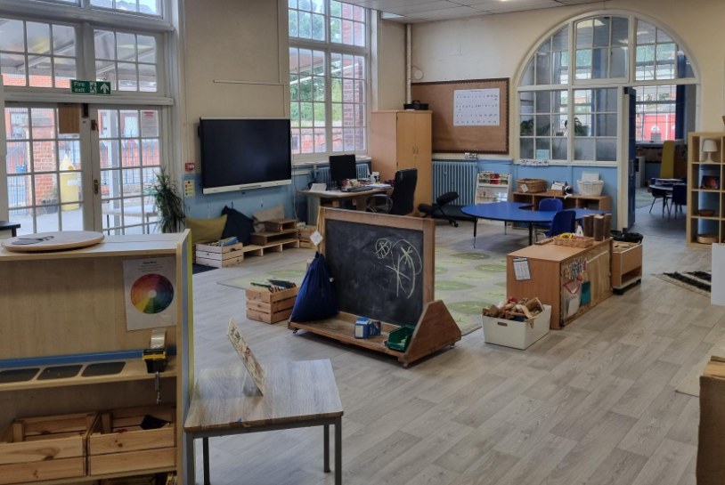
New Parent Tours for Sept 2026 intake
10am on 2nd, 9th, 16th, 23rd October,
6th Nov & 8th Jan 2026
To book, please follow this link: https://forms.office.com/Pages/ResponsePage.aspx?id=U1ejeggzwUCIxn89yQPqXJAZhXTf_XpOjb4Si4O3J9lUNkEyRjFaRjVGVERZOUMxRjlKQjUzS1NHRS4u

